Slide 1
HR Analytics Dashboard

Slide 2
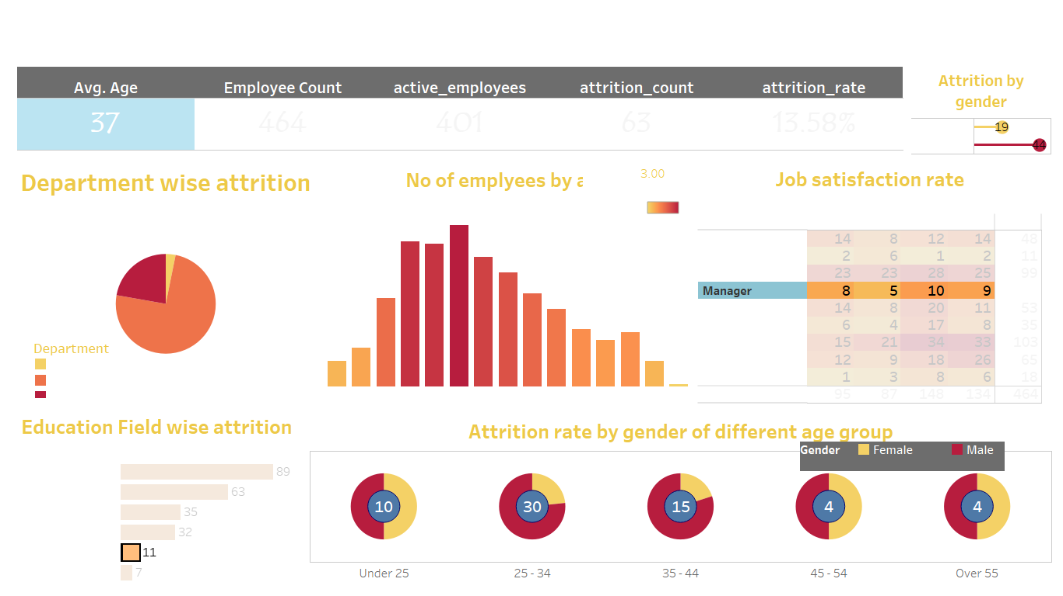

Slide 3
